Slide 1
Scanner Class

Slide 2
Reading input from the console enables the program to accept input from the user.
Predefined classes are organized in the form of packages.
This Scanner class is found in java.util package.
First include java.util package in our program.

Slide 3
import java.util.Scanner;
We include a package in a program with the help of import keyword. We can either import the java.util.Scanner class or the entire java.util package.
To import a class or a package, add one of the following lines to the very beginning of your code.
import java.util.Scanner; // This will import just the Scanner class import java.util.*; // This will import the entire java.util package

Slide 4
Scanner s=new Scanner(System.in);
After importing, we need to write the following statement in our program.
Scanner S = new Scanner (System.in);
Here by writing Scanner S,
S as an object of Scanner class.
(System.in) tells Java that this will be System Input
i.e. input will be given to the system.

Slide 5
Console input is not directly supported in Java, but you can use the Scanner class to create an object to read input from System.in
The whole line
Scanner input = new Scanner()
(System.in) creates a Scanner object and assigns its reference to the variable input.
An object may invoke its methods.

Slide 6
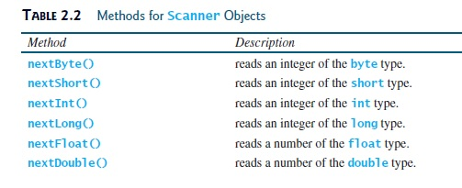

Slide 7
Scanner class
import java.util.Scanner;
class Test {
public static void main(String[] rk) {
int roll;
Scanner s=new Scanner(System.in);
roll=s.nextInt();
System.out.print(roll);
}
}

Slide 8
Scanner class
import java.util.Scanner;
class Test {
public static void main(String args[]) {
Scanner sc = new Scanner(System.in);
System.out.println("Enter your rollno");
int rollno = sc.nextInt();
System.out.println("Enter your name");
String name = sc.next();
System.out.println("Enter your fee");
double fee = sc.nextDouble();
System.out.println("Rollno:" + rollno+"name:"+name+"fee:"+fee);
sc.close();
}
}

